Slide 1
Joins

Slide 2
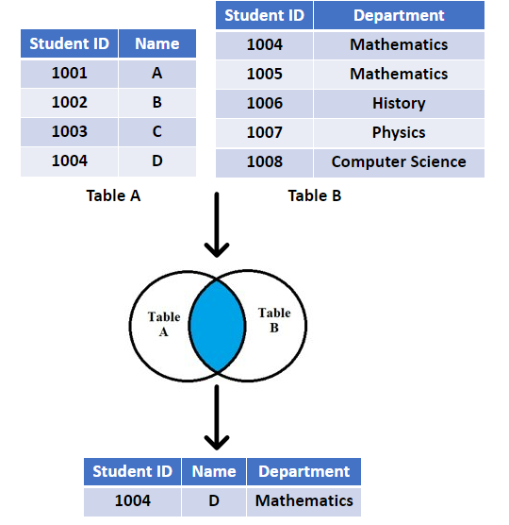
Inner join

Slide 3
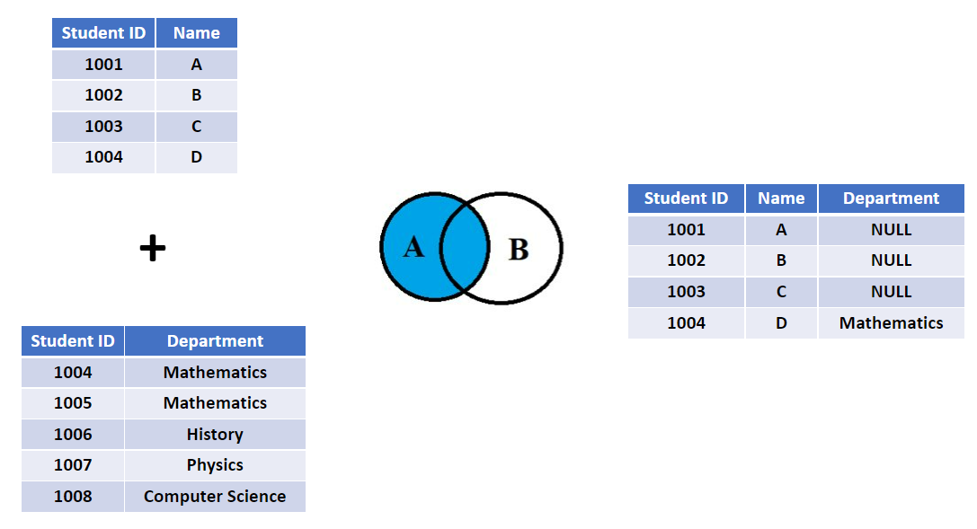
Left Join

Slide 4
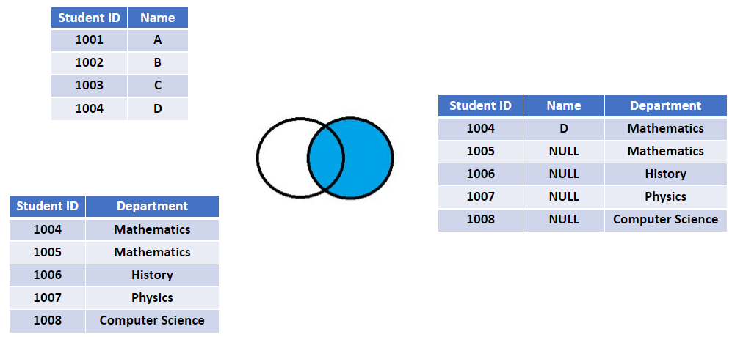
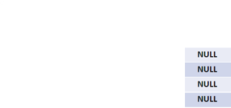
Right join

Slide 5
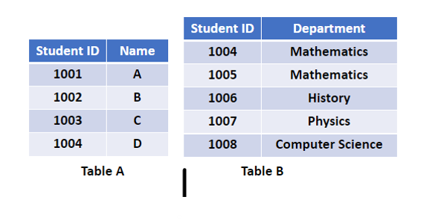
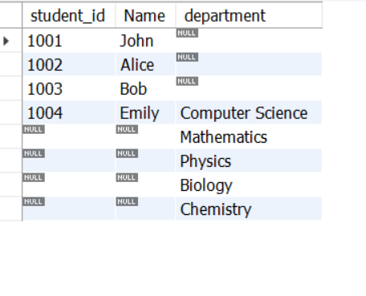
Full join

Slide 6
Self-join

Slide 7
Rabia.sql or Day 2 and Day 3 file

